Slide 1




DEPARTMENT OF COMPUTER SCIENCE
AND ENGINEERING
NAME OF THE SUBJECT : Advanced Computer Networks
NAME OF THE TOPIC : Unit 3 – Routing Algorithms
PRESENTED BY :
Mr M Ch J Sekhar
Assistant Professor

Slide 2
Unicast Routing
Protocols

Slide 3
OBJECTIVES:
To introduce the idea of autonomous systems (ASs) that divide the Internet into smaller administrative regions.
To discuss the idea of distance vector routing and the RIP that is used to implement the idea.
To discuss the idea of link state routing as the second intra-AS routing method and OSPF that is used to implement the idea.
To discuss the idea of path vector routing as the dominant inter-AS routing method and BGP that is used to implement the idea.

Slide 4
Chapter
Outline
11.1 Introduction
11.2 Intra- and Inter-Domain
Routing
11.3 Distance Vector Routing
11.4 RIP
11.5 Link State Routing
11.6 OSPF
11.7 Path Vector Routing
11.8 BGP

Slide 5
11-1 INTRODUCTION
An internet is a combination of networks connected by routers. When a datagram goes from a source to a destination, it will probably pass through many routers until it reaches the router attached to the destination network.

Slide 6
Topics Discussed in the Section
Cost or Metric
Static versus Dynamic Routing Table
Routing Protocol

Slide 7
11-2 INTER- AND INTRA-DOMAIN
ROUTING
Today, an internet can be so large that one routing protocol cannot handle the task of updating the routing tables of all routers. For this reason, an internet is divided into autonomous systems. An
autonomous system (AS) is a group of networks and routers under the authority of a single administration. Routing inside an autonomous system is called intra-domain routing. Routing between autonomous systems is called inter-domain routing

Slide 8
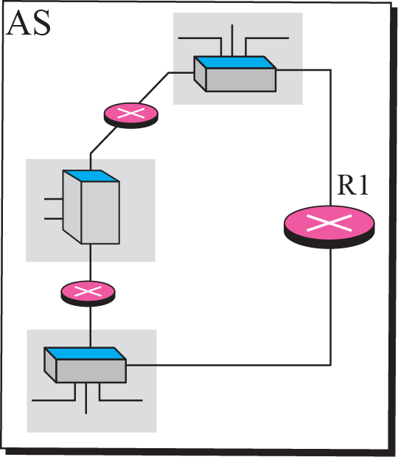
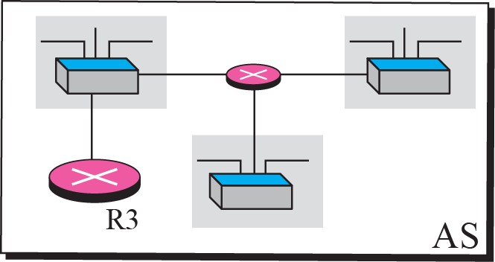

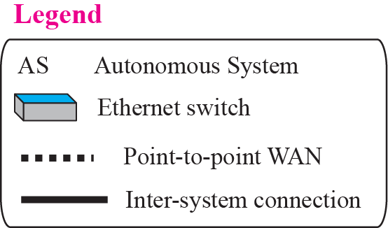
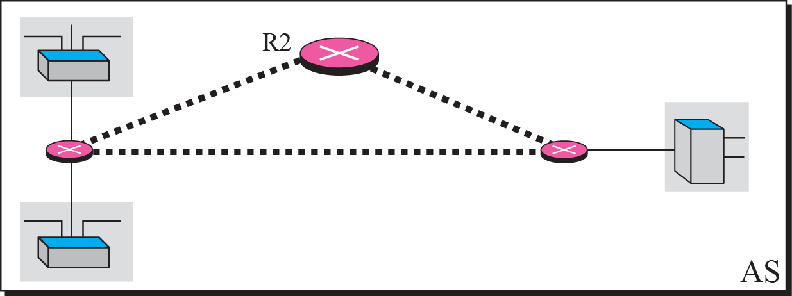
Autonomous systems

Slide 9
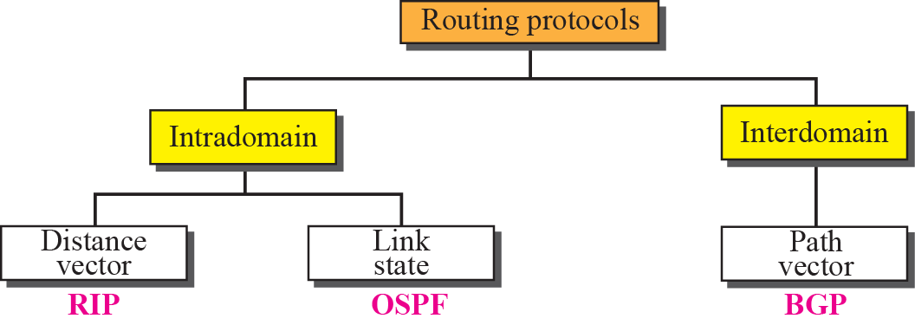
Popular routing protocols

Slide 10
11-3 DISTANCE VECTOR ROUTING
Today, an internet can be so large that one routing protocol cannot handle the task of updating the routing tables of all routers. For this reason, an internet is divided into autonomous systems. An
autonomous system (AS) is a group of networks and routers under the authority of a single administration. Routing inside an autonomous system is called intra-domain routing. Routing between autonomous systems is called inter-domain routing

Slide 11
Topics Discussed in the Section
Bellman-Ford Algorithm
Distance Vector Routing Algorithm
Count to Infinity

Slide 12
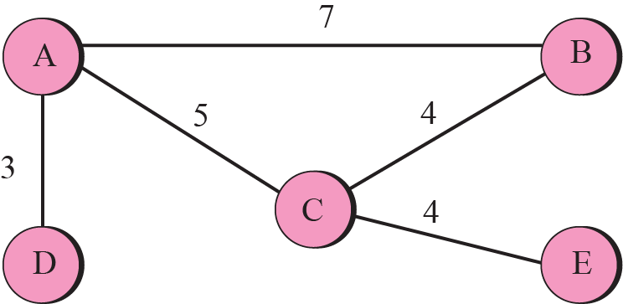
A graph for Bellman-Ford algorithm

Slide 13
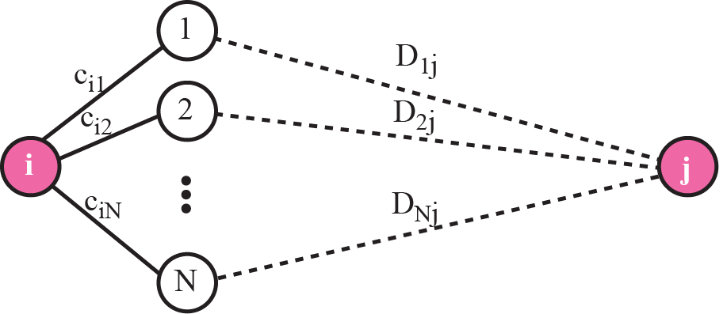
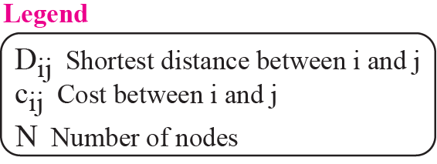
The fact behind Bellman-Ford algorithm

Slide 14
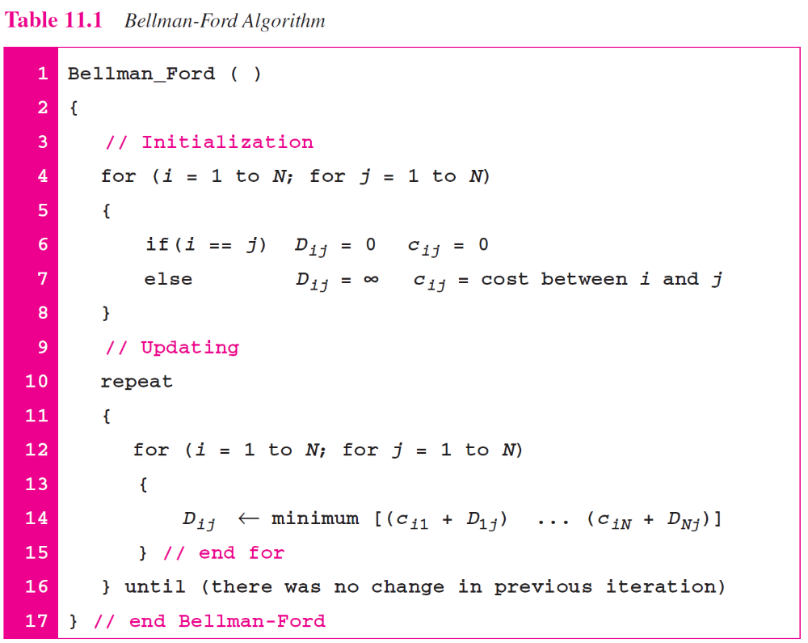

Slide 15
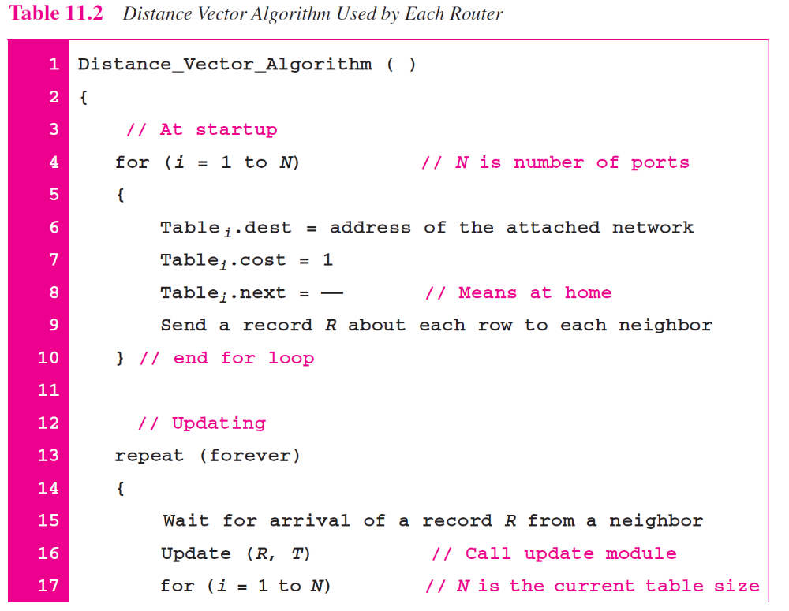

Slide 16
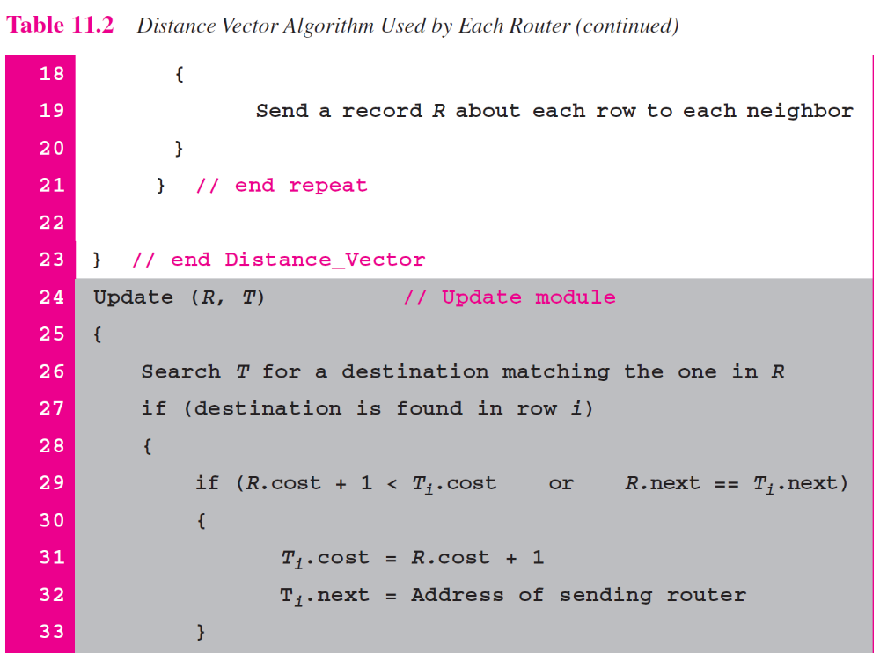
Address of
the sender of R

Slide 17
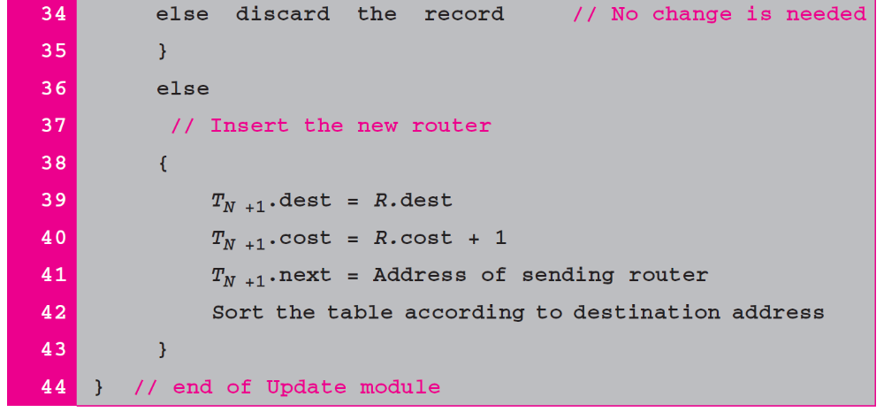

Slide 18
Updating Routing Table
If the next-node entry is different
  The receiving node chooses the row with the smaller cost
  If there is a tie, the old one is kept
If the next-node entry is the same
  i.e. the sender of the new row is the provider of the old entry
  The receiving node chooses the new row, even though the new value is infinity.

Slide 19
When to Share
Periodic Update
  A node sends its routing table, normally 30 seconds, in a periodic update
Triggered Update
  A node sends its routing table to its neighbors any time when there is a change in its routing table
    1. After updating its routing table, or
    2. Detects some failure in the neighboring links

Slide 20
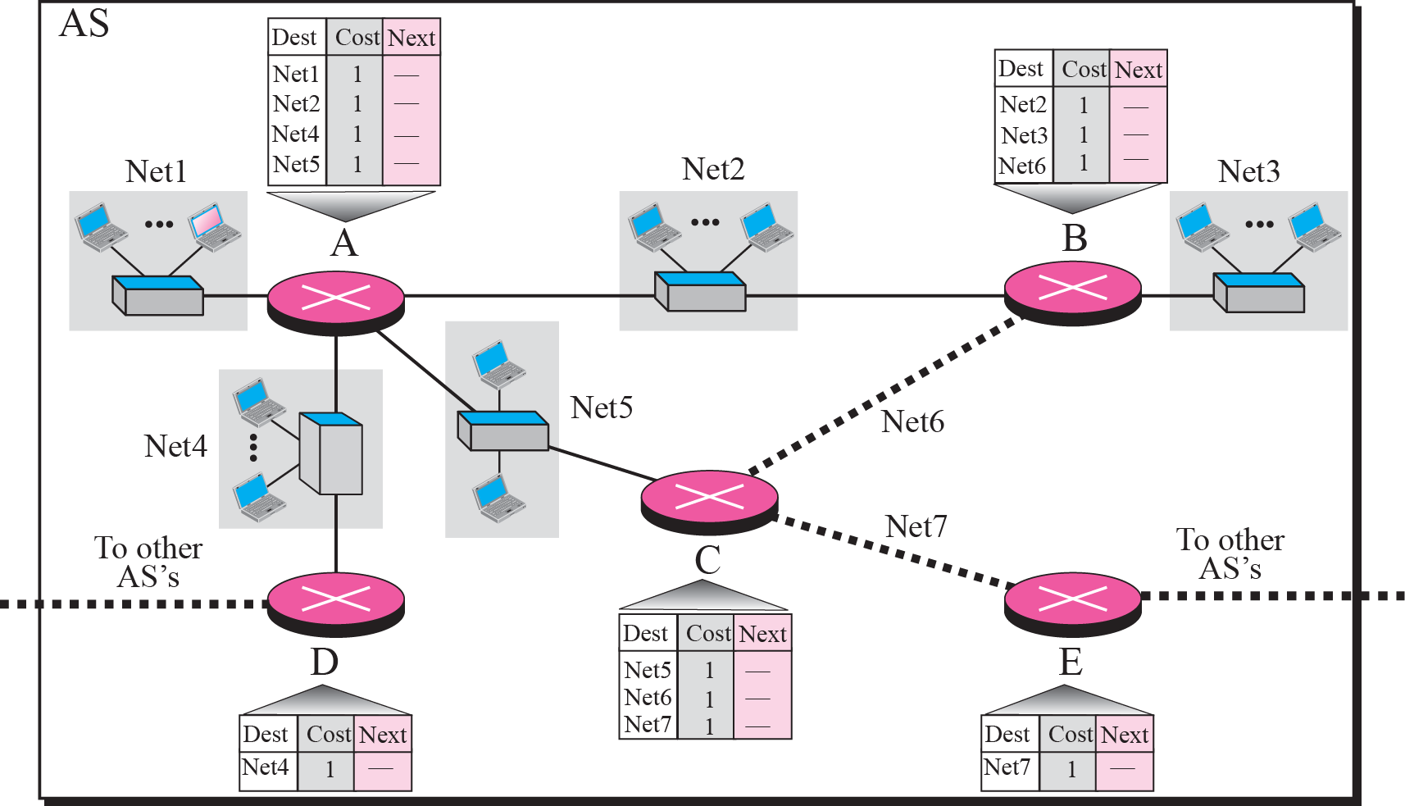

Slide 21
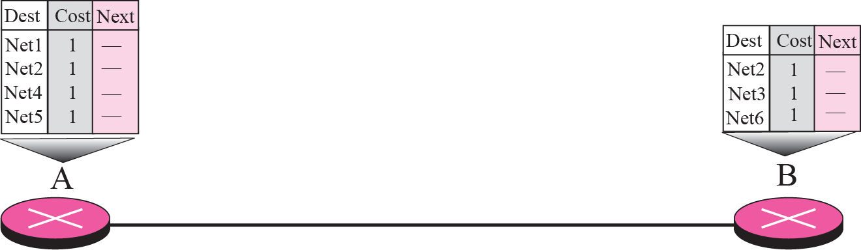




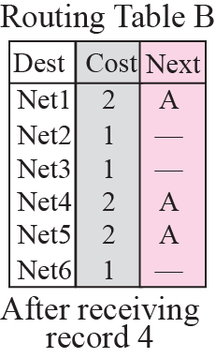
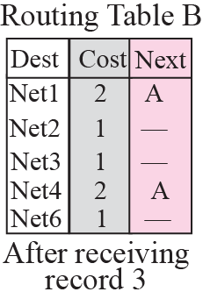
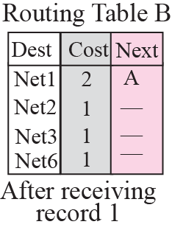
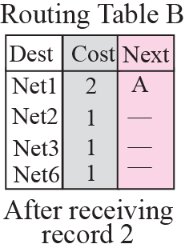

Slide 22
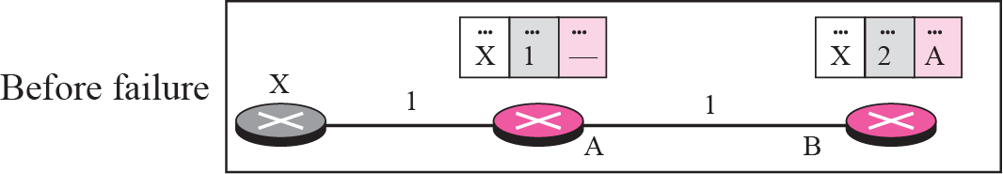
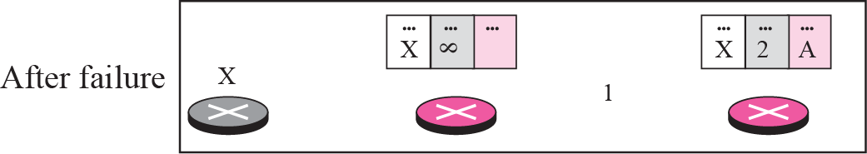
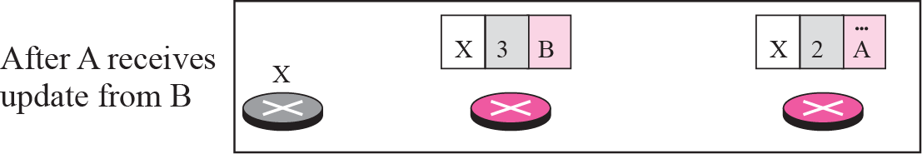
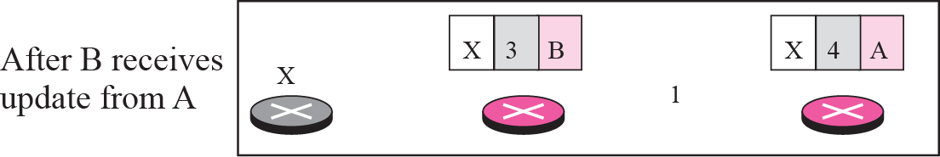
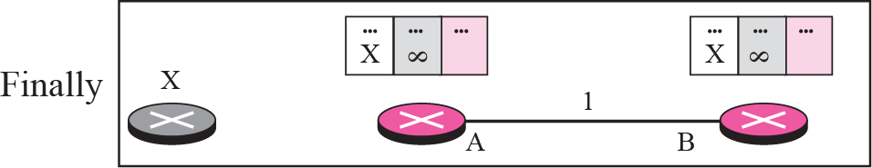

Slide 23
Two-Node Instability (1)
Defining Infinity
  Most implementations define 16 as infinity
Split Horizon
  Instead of flooding the table through each interface, each node sends only part of its table through each interface
  E.g. node B thinks that the optimum route to reach X is via A, it does not need to advertise this piece of information to A

Slide 24
Two-Node Instability (2)
Split Horizon and Poison Reverse
  One drawback of Split Horizon
    Normally, the DV protocol uses a timer and if there is no news about a route, the node deletes the route from its table
    In the previous e.g., node A cannot guess that this is due to split horizon or because B has not received any news about X recently
  Poison Reverse
    Node B can still advertise the value for X, but is the source of information is A, it can replace the distance with infinity as a warning

Slide 25
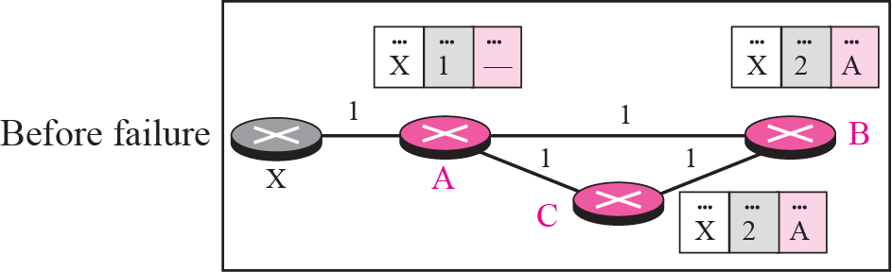
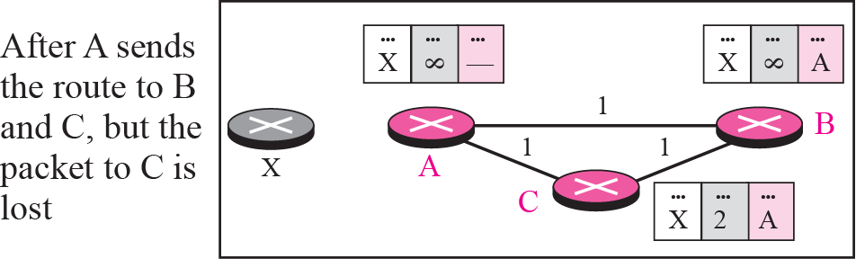
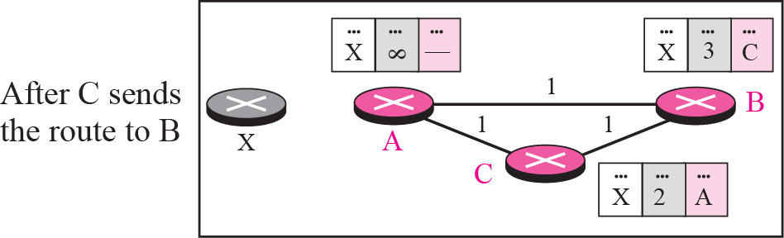
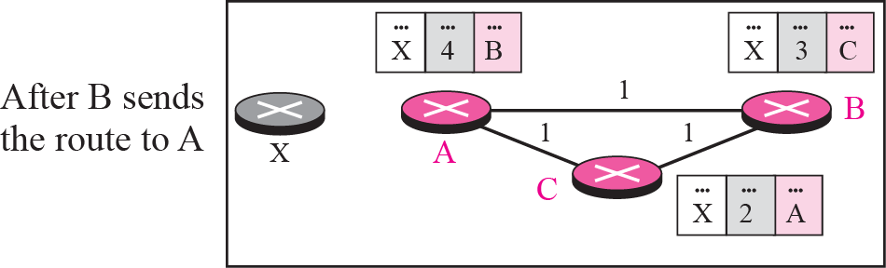
Three-node instability
If the instability is btw three nodes, stability cannot be guaranteed
Update loop until infinity

Slide 26
RIP
The Routing Information Protocol (RIP) is an intra-domain (interior) routing protocol used inside an autonomous system. It is a very simple protocol based on distance vector routing. RIP implements distance vector routing directly with some considerations.

Slide 27
Topics Discussed in the Section
RIP Message Format
Request and Response
Timers in RIP
RIP Version 2
Encapsulation

Slide 28
RIP messages
Request
  A request message is sent by a router that has just come up or by a router that has some time-out entries
  A request can ask about specific entries or all entries
Response
  A response can be either solicited or unsolicited (30s or when there is a change in the routing table)

Slide 29
RIP Timers
Periodic timer
  It controls the advertising of regular update message (25 ~ 30 sec)
Expiration timer
  It governs the validity of a route (180 sec)
  The route is considered expired and the hop count of the route is set to 16
Garbage collection timer
  A invalid route is not purged from the routing table until this timer expires (120 sec)

Slide 30
RIPv2 vs. RIPv1
Classless Addressing
Authentication
Multicasting
  RIPv1 uses broadcasting to send RIP messages to every neighbors. Routers as well as hosts receive the packets
  RIPv2 uses the all-router multicast address to send the RIP messages only to RIP routers in the network

Slide 31
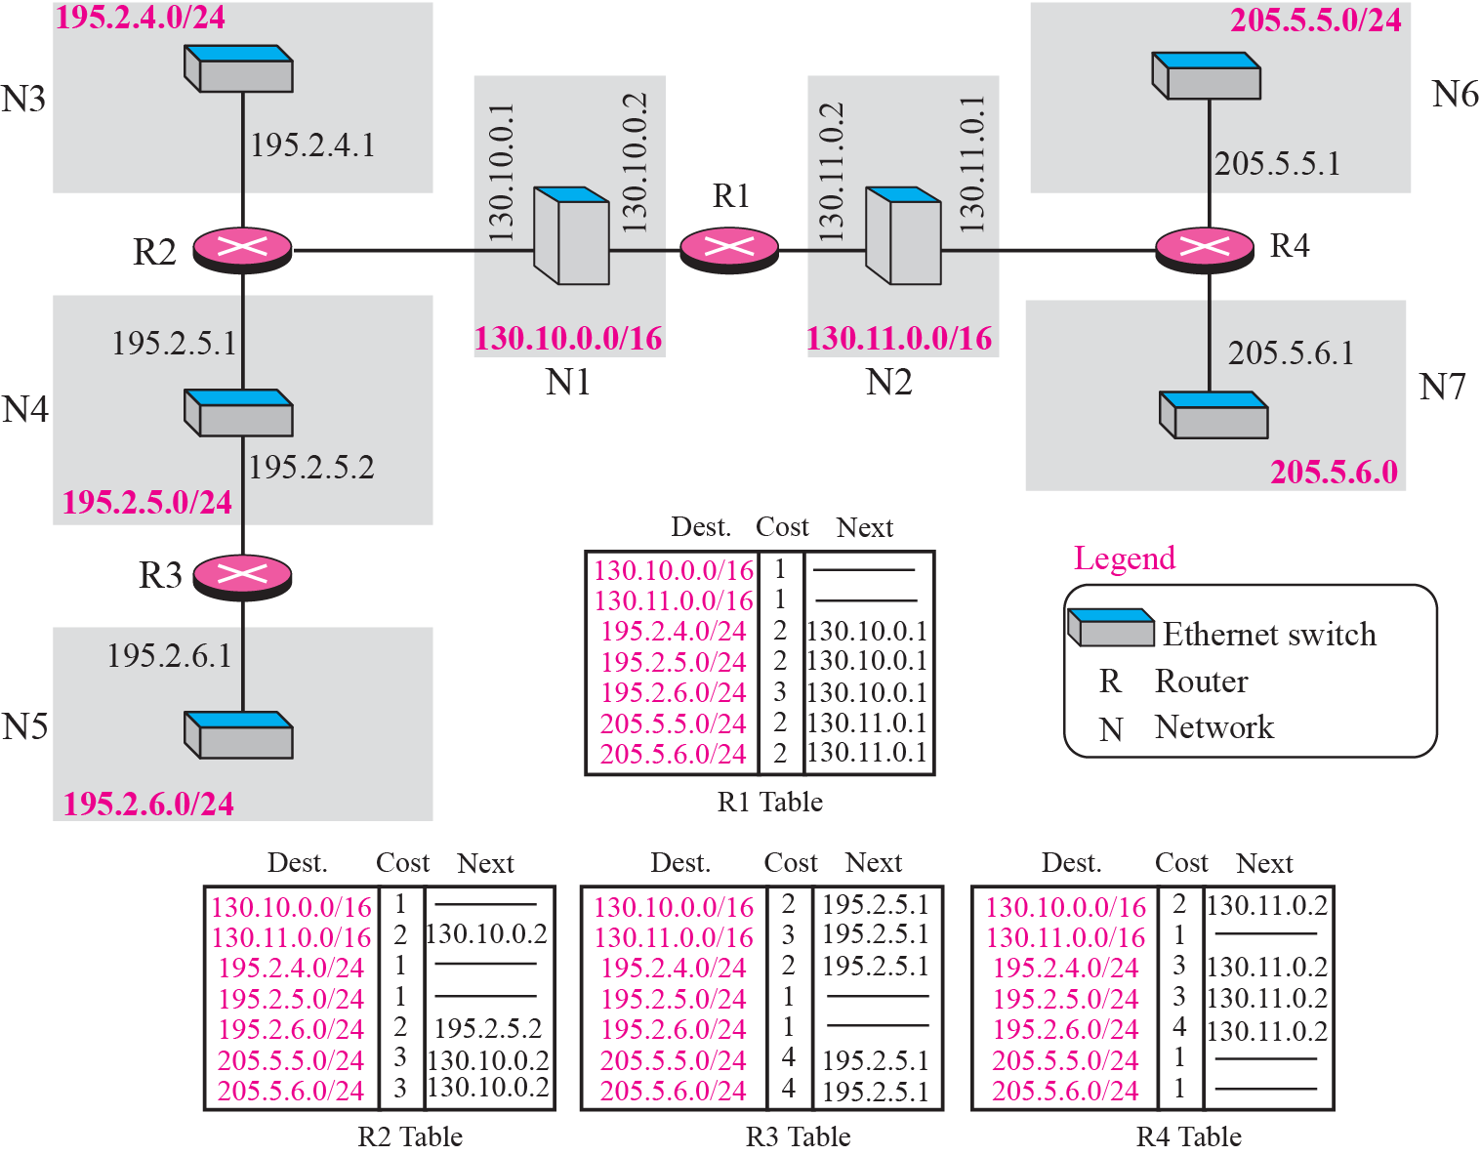
Example of a domain using RIP

Slide 32
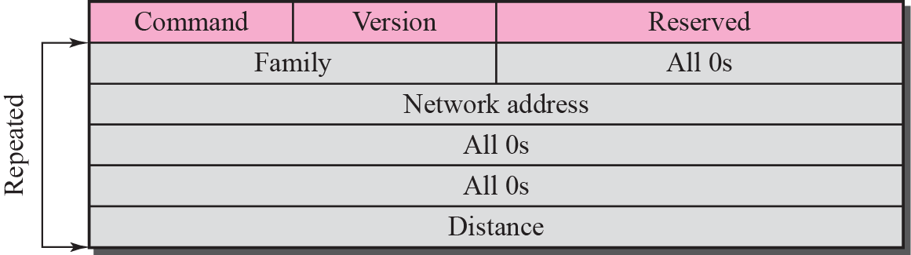
RIP message format

Slide 33
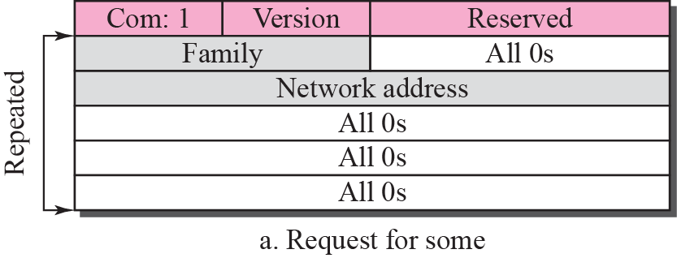
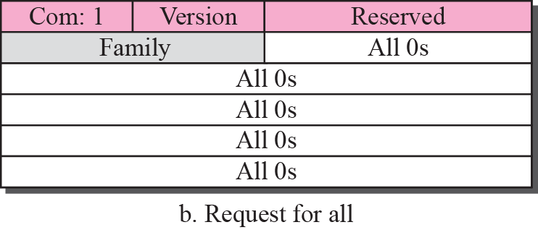
Request messages

Slide 34
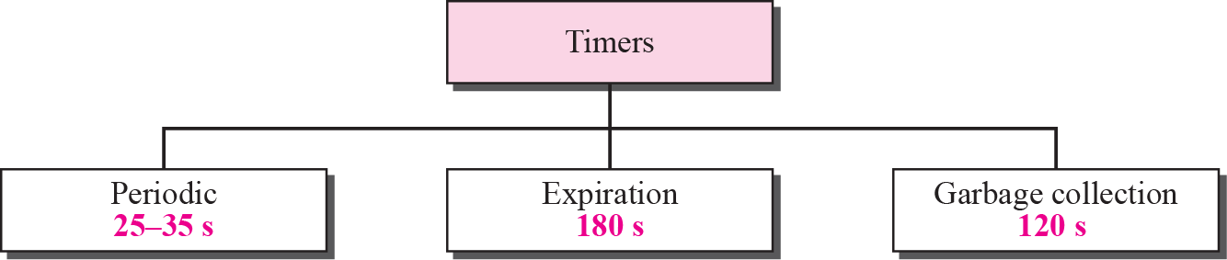
RIP timers

Slide 35
A routing table has 20 entries. It does not receive information about five routes for 200 s. How many timers are running at this time?
Solution
The 21 timers are listed below:
Periodic timer: 1
Expiration timer: 20 − 5 = 15
Garbage collection timer: 5

Slide 36
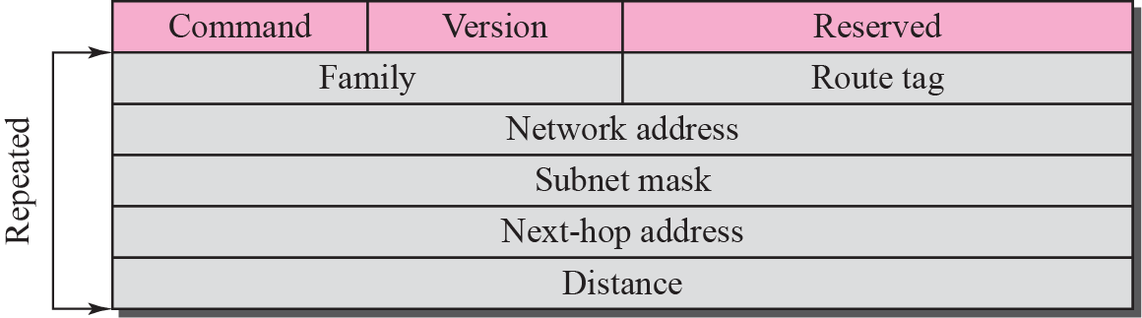
RIP version 2 format

Slide 37
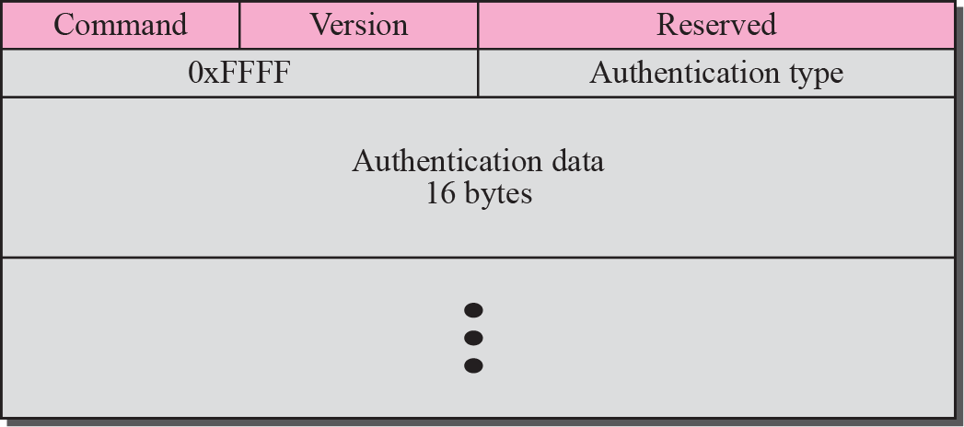
Authentication

Slide 38
RIP uses the services of UDP on well-known port 520.

Slide 39
LINK STATE ROUTING
Link state routing has a different philosophy from that of distance vector routing. In link state routing, if each node in the domain has the entire topology of the domain—the list of nodes and links, how they are connected including the type, cost (metric), and the condition of the links (up or down)—the node can use the Dijkstra algorithm to build a routing table.

Slide 40
Topics Discussed in the Section
Building Routing tables

Slide 41
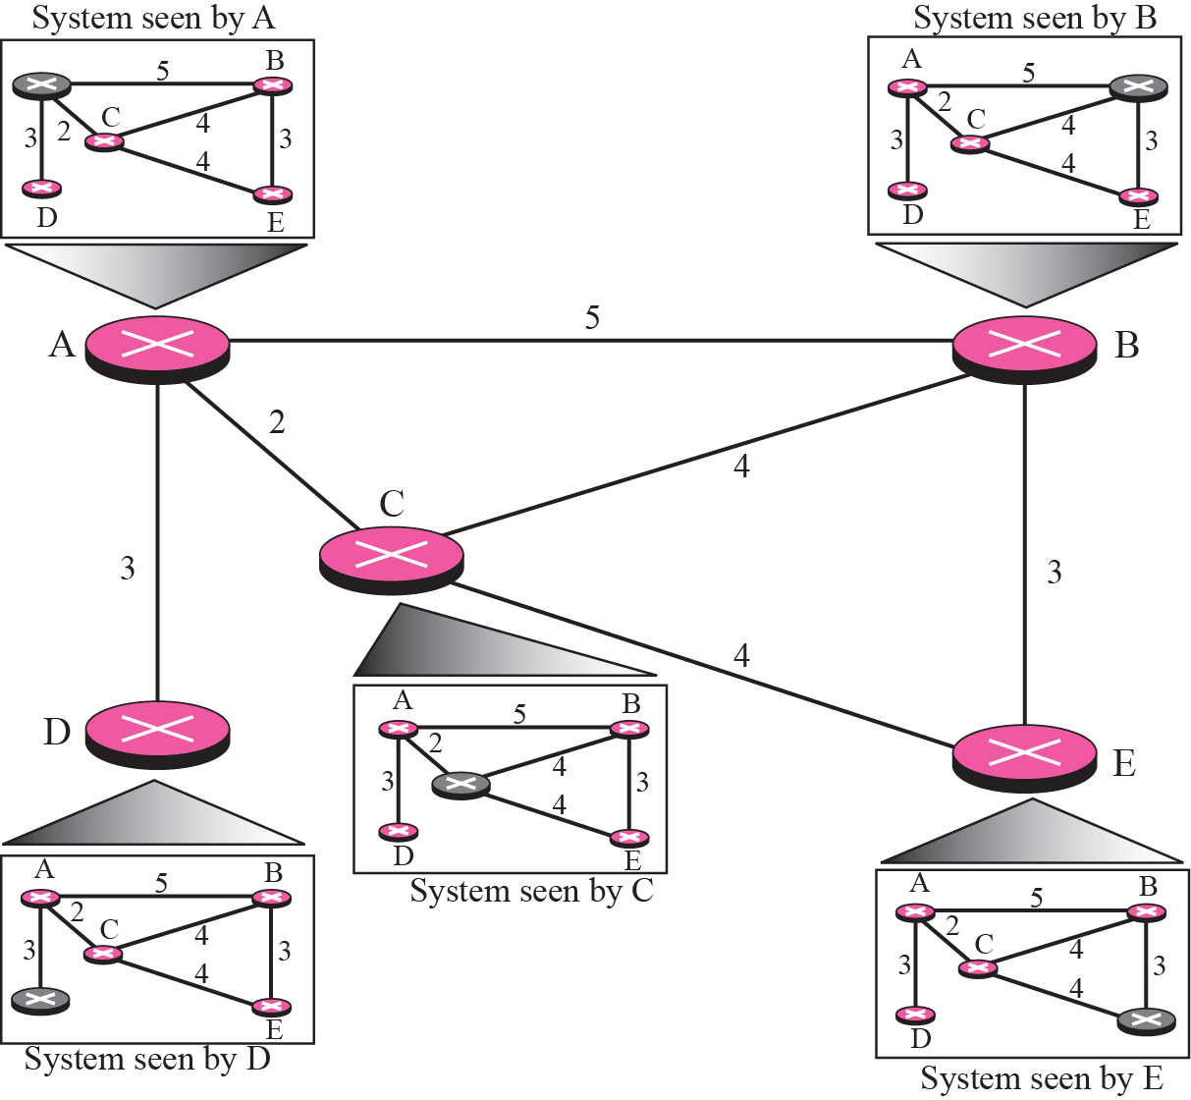
Concept of Link state routing

Slide 42
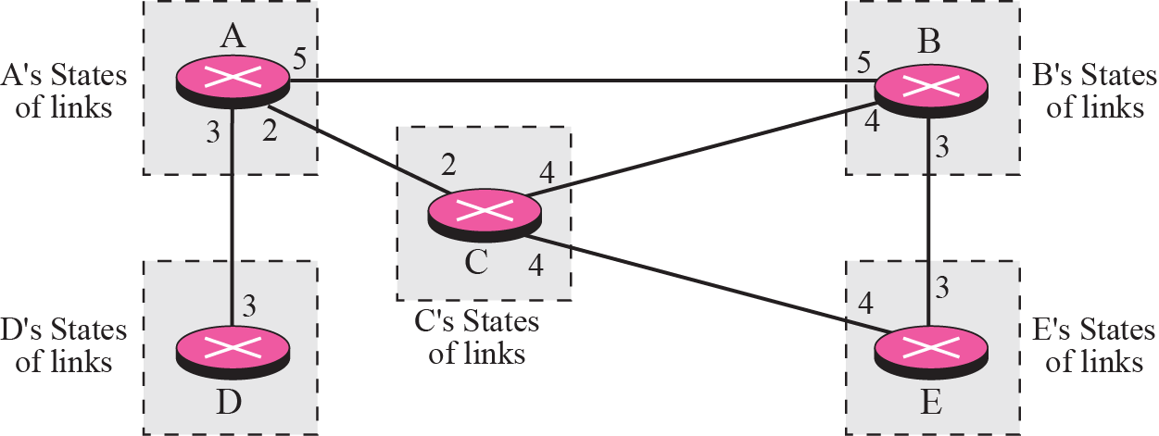
Link state knowledge

Slide 43
Building Routing Tables
Creation of the states of the links by each node, called the link state packets (LSP)
Dissemination of LSPs to every other routers, called flooding (efficiently)
Formation of a shortest path tree for each node
Calculation of a routing table based on the shortest path tree

Slide 44
Creation of LSP
LSP data: E.g. the node ID, the list of links, a sequence number, and age.
LSP Generation
  When there is a change in the topology of the domain
  On a periodic basis
    There is no actual need for this type of LSP, normally 60 minutes or 2 hours

Slide 45
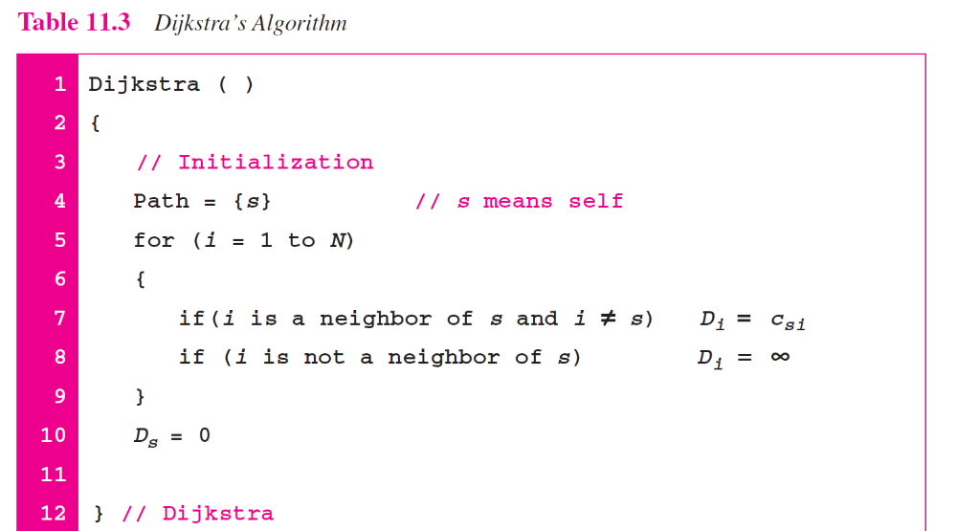

Slide 46
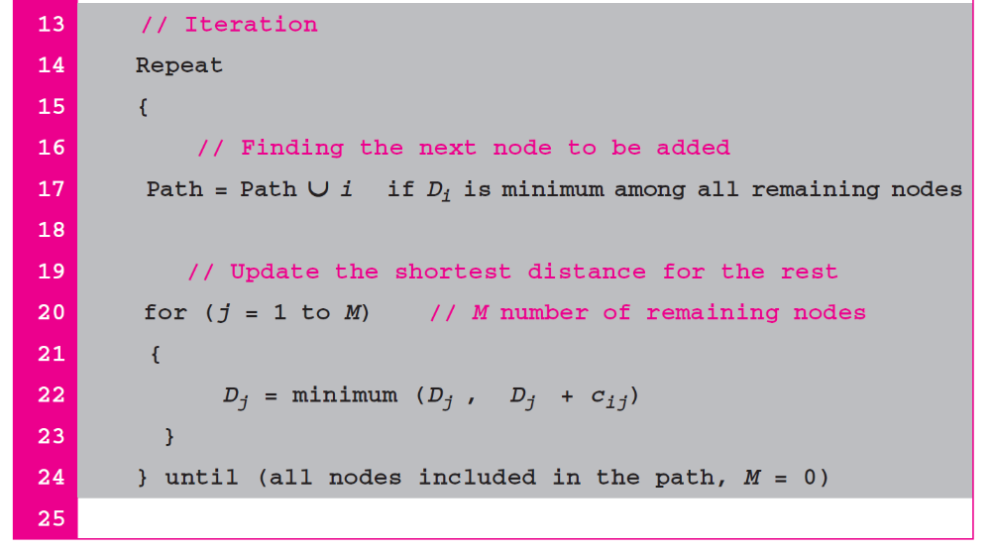
Continued

Slide 47
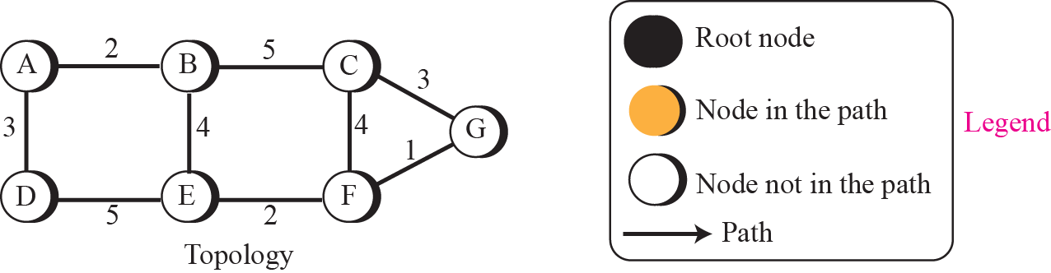
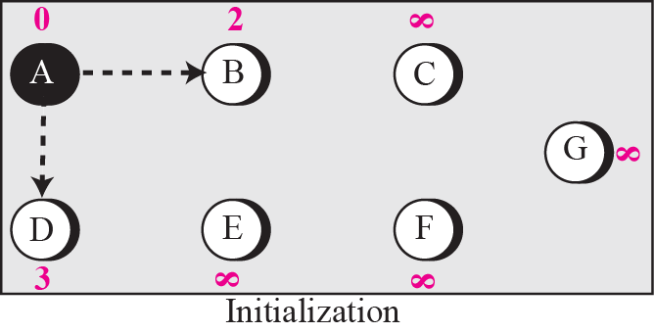
Forming shortest path three for router A in a graph

Slide 48
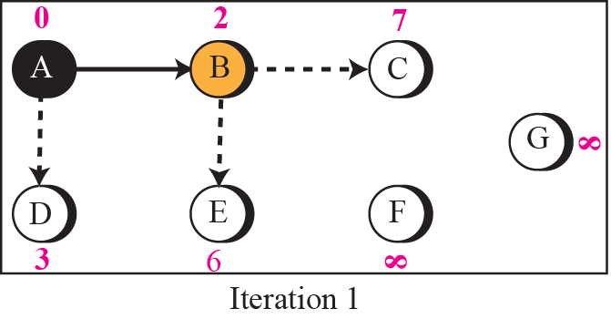
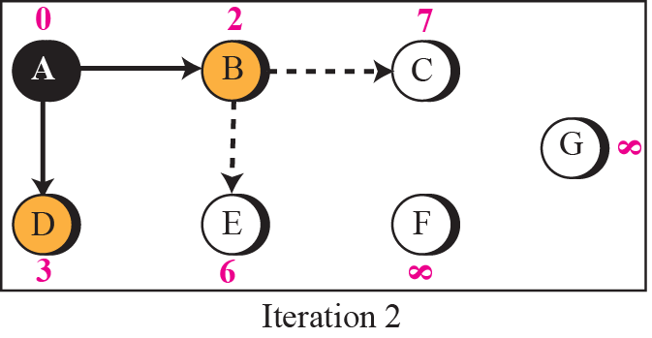
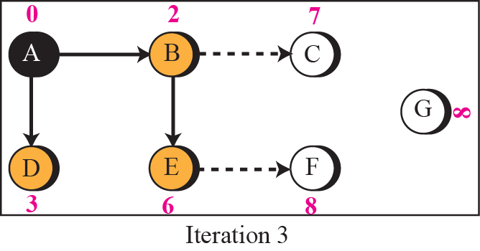
Continued

Slide 49
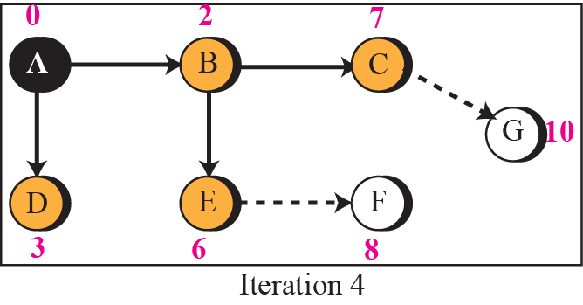
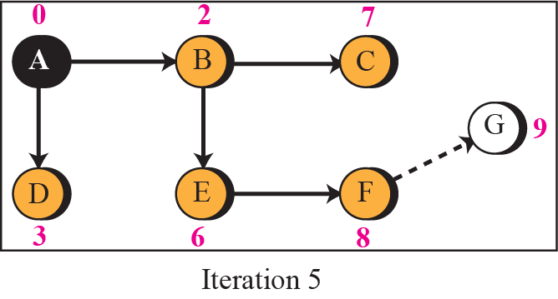
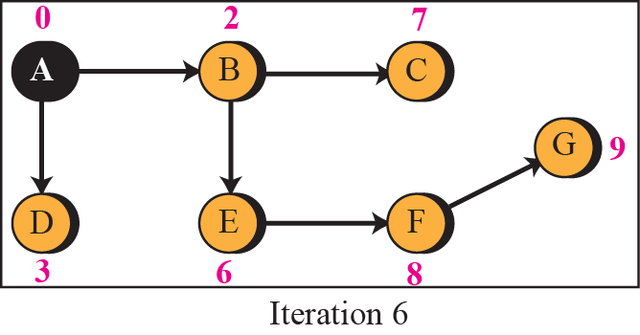
Continued

Slide 50
OSPF
The Open Shortest Path First (OSPF) protocol is an intra-domain routing protocol based on link state routing. Its domain is also an autonomous system.

Slide 51
Topics Discussed in the Section
Area
Metric
Types of Links
Graphical Representation
OSPF Packets
Link State Update Packet
Other Packets
Encapsulation

Slide 52
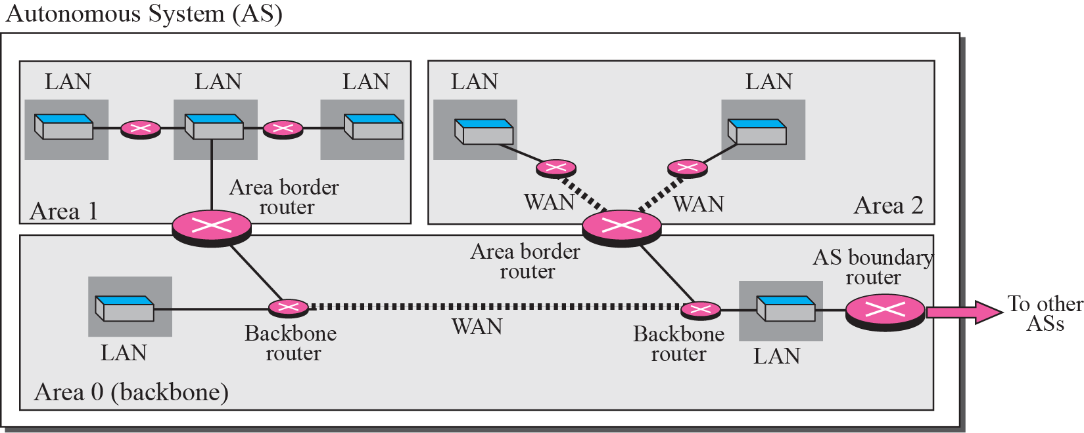
Areas in an autonomous system

Slide 53
Area in OSPF (1)
A collection of networks with area ID
Routers inside an area flood the area with routing information
Area border routers summarize the information about the area and send it to other areas
Backbone area and backbone routers
  All of the area inside an AS must be connected to the backbone

Slide 54
Area in OSPF (2)
Virtual link
  If, because of some problem, the connectivity between a backbone and an area is broken, a virtual link between routers must be created by the administration to allow continuity of the functions of the backbone as the primary area

Slide 55
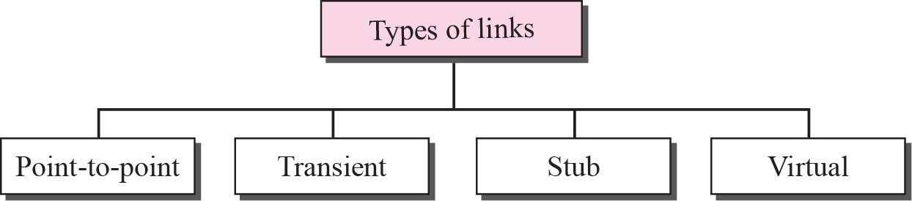
Types of links

Slide 56
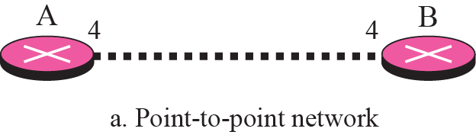
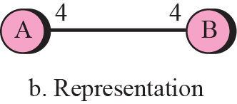
Point-to-point link

Slide 57



Transient link

Slide 58


Stub link

Slide 59


Example of an AS and its graphical representation in OSPF

Slide 60


Types of OSPF packet

Slide 61

OSPF common header

Slide 62

Link state update packet

Slide 63

LSA general header

Slide 64
LSA General Header (1)
Link state age
  When a router creates the message, the value of this field is 0
  When each successive router forwards this message, it estimates the transit time and adds it to the cumulative value of this field

Slide 65
LSA General Header (2)
E flag
  If this flag is set to 1, it means the area is a stub area (an area that is connected to the backbone area by only one path
T flag
  If this flag is set to 1, it means the router can handle multiple types of services

Slide 66
LSA General Header (3)
Advertising router
  The IP address of the router advertising this message
Link state sequence number
  A sequence number assigned to each link state update message

Slide 67
LS Type and LS ID
Link state type | Link state ID
Router link | IP address of the router
Network link | IP address of the designated router
Summary link to network | Address of the network
Summary link to AS boundary | IP address of the boundary router
External link | Address of the network

Slide 68

Router link

Slide 69

Router link LSA

Slide 70


Slide 71

Example

Slide 72

Solution to Example

Slide 73

Network link

Slide 74

Network link advertisement format

Slide 75

Summary link to network

Slide 76

Summary link to network LSA

Slide 77

Summary link to AS boundary router

Slide 78

Summary link to AS boundary router LSA

Slide 79

External link

Slide 80

External link LSA

Slide 81

Hello packet
OSPF uses the hello message to create neighborhood relationship and to test the reachability of neighbors.
This is the first step in link state routing. Before a router can flood all of the other routers with information about its neighbors, it must first greet it neighbors.

Slide 82

Database description packet
When a router is connected to the system for the first time or after a failure, it needs the complete link state database immediately. Therefore, it sends hello packets to greet its neighbors. If this is the first time that the neighbors hear from the router, they send a database description message.
The database description packet does not contain complete database information; it only gives an outline, the title of each lines in the database.

Slide 83

Link state request packet

Slide 84

Link state acknowledgment packet

Slide 85
PATH VECTOR ROUTING
Distance vector and link state routing are both interior routing protocols. They can be used inside an autonomous system. Both of these routing protocols become intractable when the domain of operation becomes large. Distance vector routing is subject to instability if there is more than a few hops in the domain of operation. Link state routing needs a huge amount of resources to calculate routing tables. It also creates heavy traffic because of flooding. There is a need for a third routing protocol which we call path vector routing.

Slide 86
Topics Discussed in the Section
Reachability
Routing Table

Slide 87






Reachability

Slide 88



Stabilized table for three autonomous system

Slide 89



Routing tables after aggregation

Slide 90
BGP
Border Gateway Protocol (BGP) is an interdomain routing protocol using path vector routing. It first appeared in 1989 and has gone through four versions.

Slide 91
Topics Discussed in the Section
Types of Autonomous Systems
Path Attributes
BGP Sessions
External and Internal BGP
Types of Packets
Packet Format
Encapsulation

Slide 92


Internal and external BGP sessions
A speaker node advertises the path, not the metric of the nodes, in its AS or other ASs.

Slide 93
Path Vector Routing (1)
Sharing
  A speaker in an AS shares its table with immediate neighbors
Updating
  Adding the nodes that are not in its routing table and adding its own AS and the AS that sent the table
  The routing table shows the path completely

Slide 94
Path Vector Routing (2)
Loop prevention
  A route checks to see if its AS is in the path list to the destination
Policy routing
  If one of the ASs listed in the path is against its policy, it can ignore that path and that destination
  It does not update its routing table with the path, and it does not send this message to its neighbors

Slide 95
Path Vector Routing (3)
Optimum path
  Problem: each AS that is included in the path may use a different criteria for the metric
  The optimum path is the path that fits the organization
  For Fig. 14-49, the author chose the one that had the smaller number of ASs
  Other criteria: security, safety, reliability, etc.

Slide 96
Types of AS
Stub AS
  Only one connection to another AS (only a source or sink for data traffic)
Multihomed AS
  More than one connection to other AS, but it is still only a source or sink for data traffic
Transit AS
  Multihomed AS that also allows transient traffic

Slide 97

Types of BGP messages

Slide 98

BGP packet header

Slide 99

Open message

Slide 100

Update message

Slide 101
Path Attributes
ORIGIN
  The source of the routing information (RIP, OSPF, etc)
AS_PATH
  The list of ASs through which the destination can be reached
NEXT-HOP
  The next router to which the data packet should be sent

Slide 102
NLRI
Network layer reachability information
  It defines the network that is actually advertised by this message
  Length field and IP address prefix
  BGP4 supports classless addressing and CIDR

Slide 103

Keepalive message

Slide 104

Notification message

Slide 105


